Slide 1
5CS021 Numerical Methods and Concurrency
More Multithreading

Slide 2
Ending and returning results from a thread
void pthread_exit(void *retval)
This function terminates the calling thread and returns a value via the location pointed to by retval.
retval must point to a valid memory location when the calling thread terminates.
retval must not point to a local thread variable.

Slide 3
pthread_exit()
#include <pthread.h> #include <stdio.h>
char retval[] = "Hello there!"; void *threadOne(void *p){
pthread_exit(retval);
}
void main(){
void *pretval1; pthread_t thrID1;
pthread_create(&thrID1, NULL, threadOne, NULL);
pthread_join(thrID1, &pretval1); printf("*pretval1 = %s\n", (char *)pretval1);
}

Slide 4
Returning an int value
int gretval=0;
void *threadOne(void *p){ gretval = 42; pthread_exit(&gretval);
}
void main(){
void *pretval1;
int retval; pthread_t thrID1;
pthread_create(&thrID1, NULL, threadOne, NULL); pthread_join(thrID1, &pretval1);
retval=*(int *)pretval1; printf("*pretval1 = %d\n", retval);
}

Slide 5
Return dynamic memory
void *threadOne(void *p){ char *retval;
retval= malloc(1000); strcpy(retval, "Hello world!"); pthread_exit(retval);
}
void main(){ void *pretval;
pthread_t thrID1;
pthread_create(&thrID1, NULL, threadOne, NULL); pthread_join(thrID1, &pretval); printf("*pretval = %s\n", (char *)pretval); free(pretval);
}

Slide 6
Return dynamic memory
void *threadOne(void *p){ int *retval;
retval= malloc(sizeof(int));
*retval = 42; pthread_exit(retval);
}
void main(){ void *pretval; int retval;
pthread_t thrID1;
pthread_create(&thrID1, NULL, threadOne, NULL); pthread_join(thrID1, &pretval);
retval=*(int *)pretval; printf("retval = %d\n", retval);
}

Slide 7
Cancelling a running thread
int pthread_cancel(pthread_t thread)
This function sends a cancellation request to the specified thread.
The thread can be canceled at any time, usually immediately, but this is not guaranteed

Slide 8
Cancelling a running thread
#include <pthread.h> #include <stdio.h> #include <unistd.h>
void *threadFunc(void *p){ long i;
for(i = 0; i <10000000; i++){
printf("i = %ld\n", i);
}
}
void main(){ pthread_t thrID;
pthread_create(&thrID, NULL, threadFunc, NULL); sleep(1);
pthread_cancel(thrID);
pthread_join(thrID, NULL);
}

Slide 9
Cancelling a run-away thread
#include <pthread.h>
int counter = 0;
void *threadFunc(void *p){ long i;
for(i = 0; i <1000000; i++){
printf("i = %ld\n", i); counter = i;
}
}
void main(){ pthread_t thrID;
pthread_create(&thrID, NULL, threadFunc, NULL);
sleep(1);
if (counter < 100000){ pthread_cancel(thrID); printf("Thread cancelled\n");
}
pthread_join(thrID, NULL);
}

Slide 10
5CS021 Numerical Methods and Concurrency
Thread Synchronization

Slide 11
Race Condition
When the order of execution of statements changes the result of an operation then we call such condition as Race condition.
A race condition occurs when two or more threads can access shared data and they try to change it at the same time.

Slide 12
shared=10;
T1
int x =Read(shared) x=x+1;
sleep(1); shared=x;
T2
int y=Read(shared) y=y-1;
sleep(1); shared=y;

Slide 13

Critical Sections
When multiple threads share global resources, they may interfere with each other
We need a protection mechanism to prevent this interference
Critical section - section of code that need this protection

Slide 14

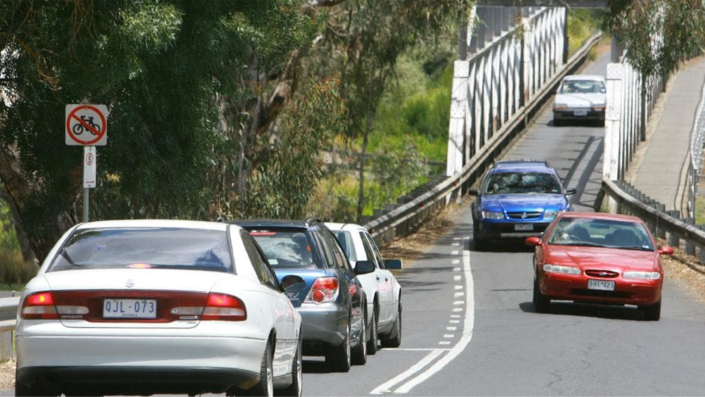
Real Life Critical Section

Slide 15
Thread interference
#include<stdio.h> #include<pthread.h> int shared=10;
void* fun1(void* arg)
{
int x=shared; x++;
sleep(1); shared=x;
}
void* fun2(void* arg)
{
int y=shared; y--;
sleep(1); shared=y;
}
void main()
{
pthread_t thread1,thread2;
pthread_create(&thread2,NULL,fun1,NULL); pthread_create(&thread1,NULL,fun2,NULL);
pthread_join(thread2,NULL);
pthread_join(thread1,NULL); printf("%d\n",shared);
}

Slide 16
Critical Section
The critical section that needs to be protected in this code is this bit in both threads:
int x=shared;
x++;
sleep(1); shared=x; and
int y=shared; y--;
sleep(1); shared=y;

Slide 17
Protecting Critical Sections
The critical section is protected by mutex: pthread_mutex_lock(mutex)
int y=shared; y--;
sleep(1); shared=y;
pthread_mutex_unlock(mutex)

Slide 18
Pthread Mutex function
pthread_mutex_init (mutex,attr)
Initialises the mutex, "attr" is optional,; should be set to NULL
pthread_mutex_destroy (mutex)
Frees the resources used by the mutex
pthread_mutex_lock (mutex)
Locks the mutex. If the mutex is already locked by another thread, it will wait, until it acquires the lock
pthread_mutex_unlock (mutex)
Unlocks the mutex. If another thread is waiting to lock the mutex, the lock will be transfered to the waiting thread.
pthread_mutex_t
This is the mutex datatype.

Slide 19
Deadlocks
With mutexes, there is the possibility of deadlocks.
This is when all the threads are waiting for different mutexes which are locked by other threads. E.g.:
Thread A locks Mutex 1
Thread B locks Mutex 2
Thread A attempts to lock Mutex 2
Thread B attempts to lock Mutex 1
Deadlock!

Slide 20
Avoiding deadlocks
pthread_mutex_trylock (mutex)
pthread_mutex_trylock() will attempt to lock a mutex.
However, if the mutex is already locked, the routine will return immediately with a non-zero error code.
This may be useful in preventing deadlock conditions

Slide 21
Questions?

Slide 22
Questions?

